Slide 1
Term Project
Progress Report
B11901150 易靖杰 B11901173 陳顗帆

Slide 2
Project Idea
STM32 record user command
STM32 preprocess audio data
STM32 transmit ML model input via WiFi to RPi
RPi implement keyword recognition model
RPi play music using YouTube according to user command

Slide 3
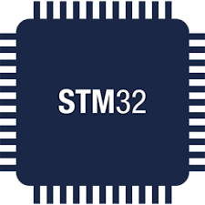
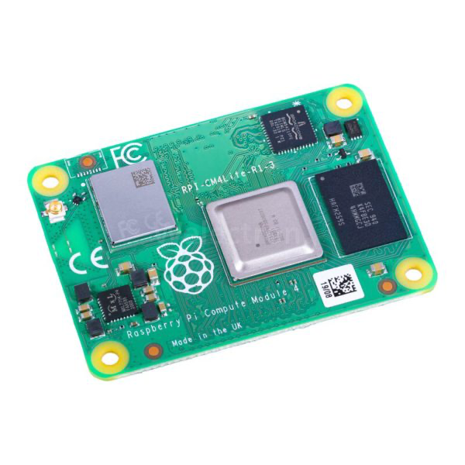
Expected Data Flow
User button pressed trigger DFSDM
DMA full trigger data preprocessing
Wifi send data to RPi
Receive WiFi data
Recognize keyword
Play music via YouTube and control speaker

Slide 4
TABLE OF CONTENTS
01
02
03
STM32
Generate training data
RPI
Audio recording
Wifi transmission
RTOS handling
Text to Speech
WIFI server
Audio preproccesing
Keyword Searching

Slide 5
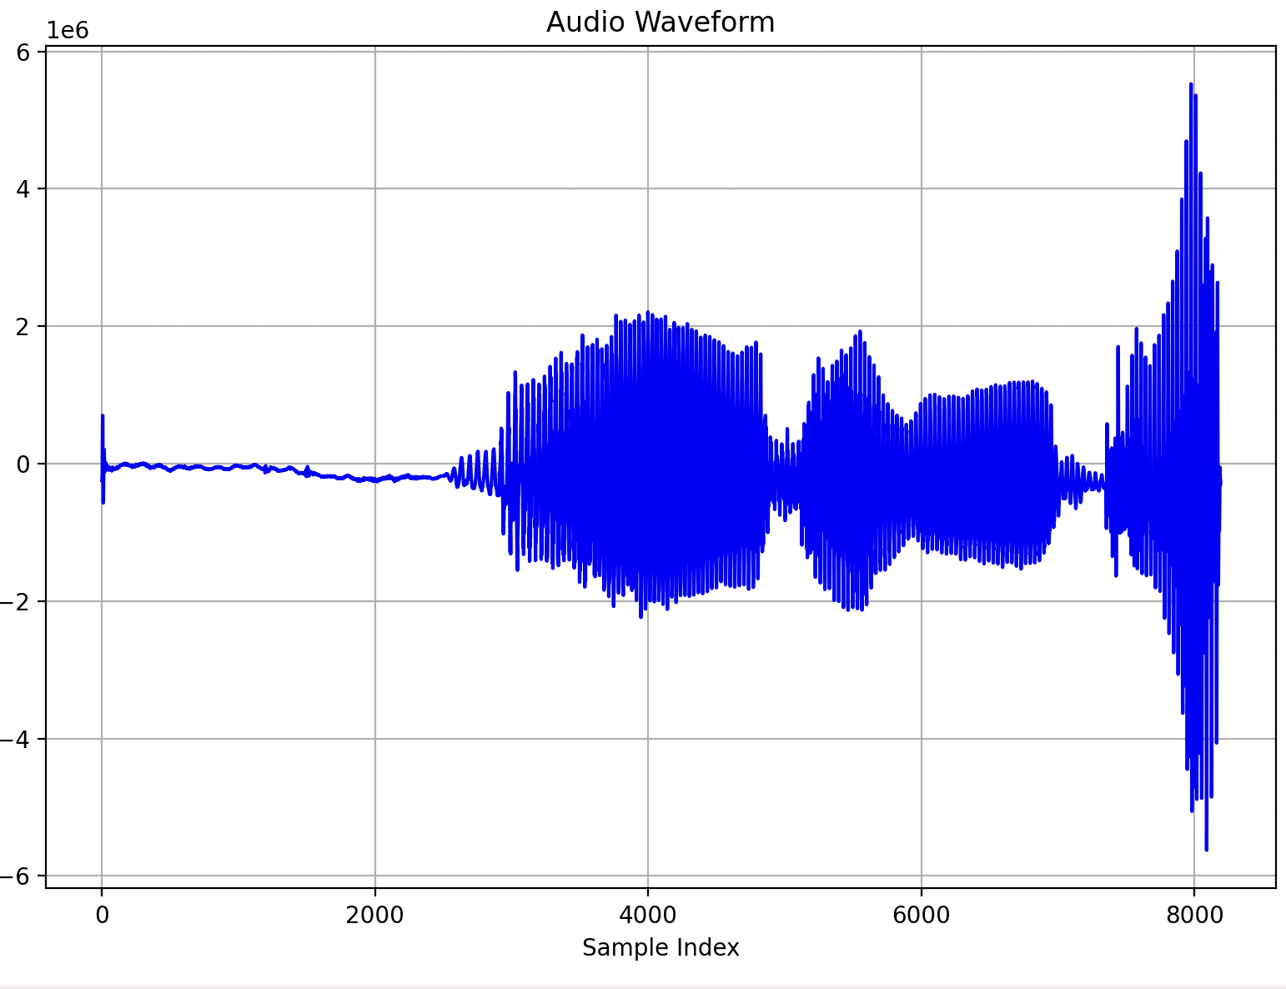
STM32 AUDIO
Sampling frequency: 8000 Hz
Total SRAM on STM: 128KB
Duration: 1 second
RTOS thread: Button press event, DMA triggered interrupt
Bandpass Filter

Slide 6
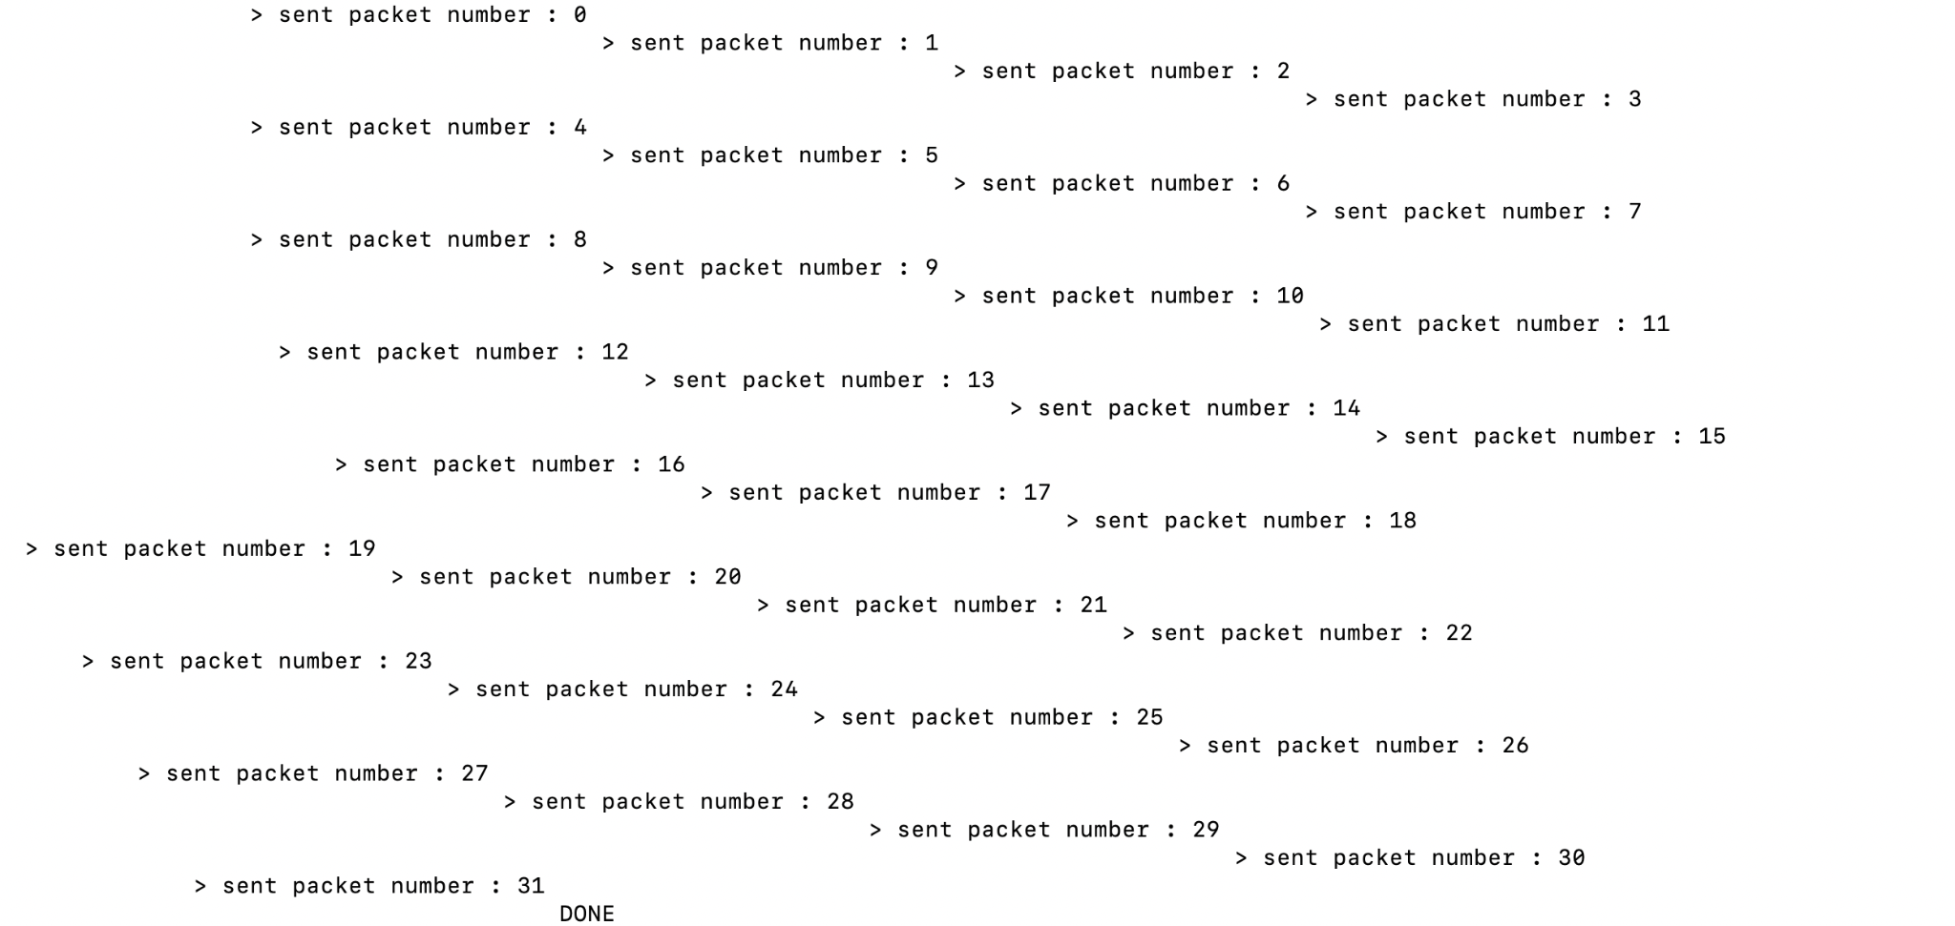
STM32 WiFI Tansmission
TxData size:
8000Hz x 1sec x 32bits
Packet size:
250 x 32bits
Number of packet required:
32

Slide 7
STM32 RTOS THREAD HANDING
Create Mutex to prevent Multiple button press event
Highest priority: WIFI Transmit
Normal Priority: Button Press
Lowest Priority: DMA

Slide 8

Generate training data
Next
TEXT to SPEECH model:
tts_models/en/vctk/vits
SAMPLING_RATE = 8000 Hz
DURATION = 1 sec
KEYWORDS = ["Play.", "Pause.", "Next.", "Previous."]
Pause
Play
Previous

Slide 9
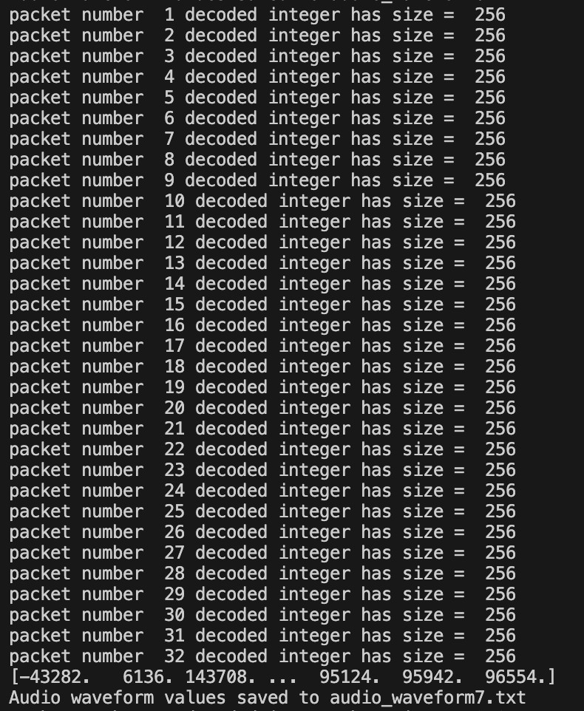
Wifi Server
Receive transmission from Client (STM32)
Sends acknowledgement
Handles Misdelivery

Slide 10
Wifi Server
Receive transmission from Client (STM32)
Sends acknowledgement
Handles Misdelivery

Slide 11
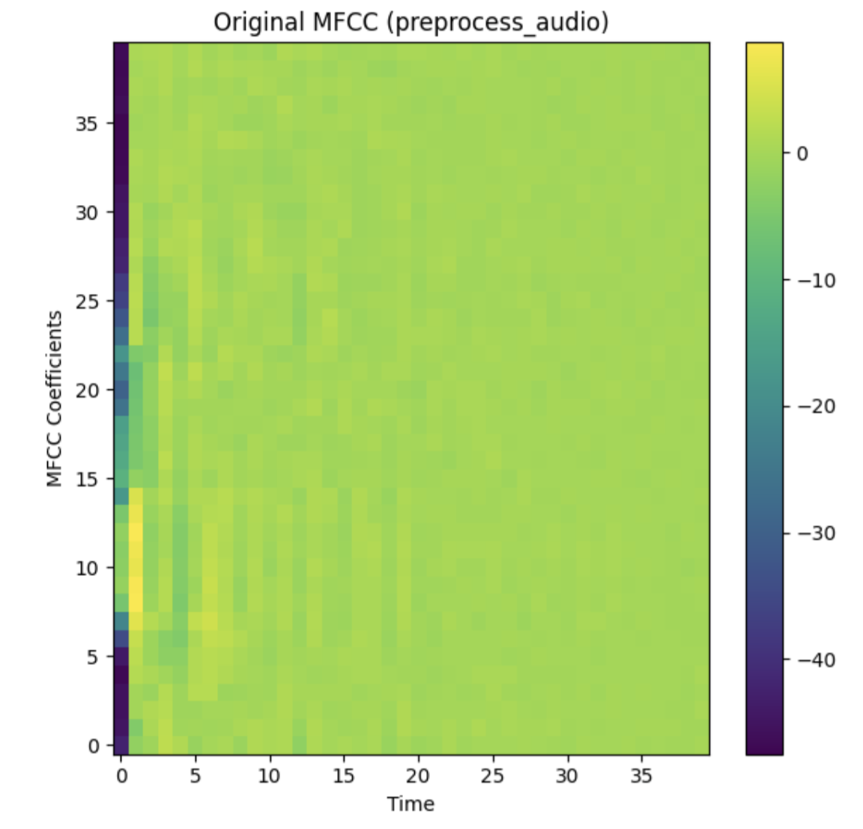
Audio Preprocessing
Generates MFCC:
Normalize Audio
STFT
compute log spectrogram
compute MFCC

Slide 12
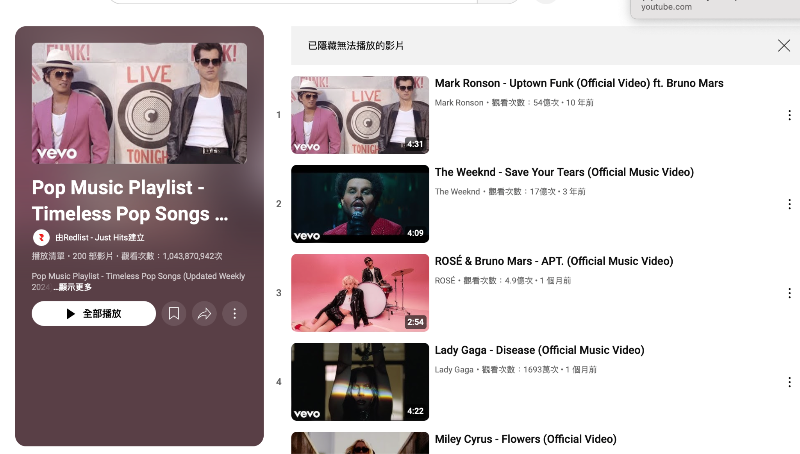
Keyword Searching
Crawlweb using keyword to find youtube link
Download Music from link
Play Music
Pause/ Next / Previous/ Stop Music

Slide 13
Currently Working On
Preprocessing on STM to generate MFCC
can implement STFT
needs to be faster
improve quality
Training Model
finished designing architecture
need to preproccess generated data

Slide 14
Work Distribution
易靖杰(50%)
STM data preprocessing
RTOS
RPI music player
陳顗帆(50%)
STM and RPI Wifi
RPI ML Model
STM recording

Slide 15
THANKS
Please keep this slide for attribution

